Slide 1
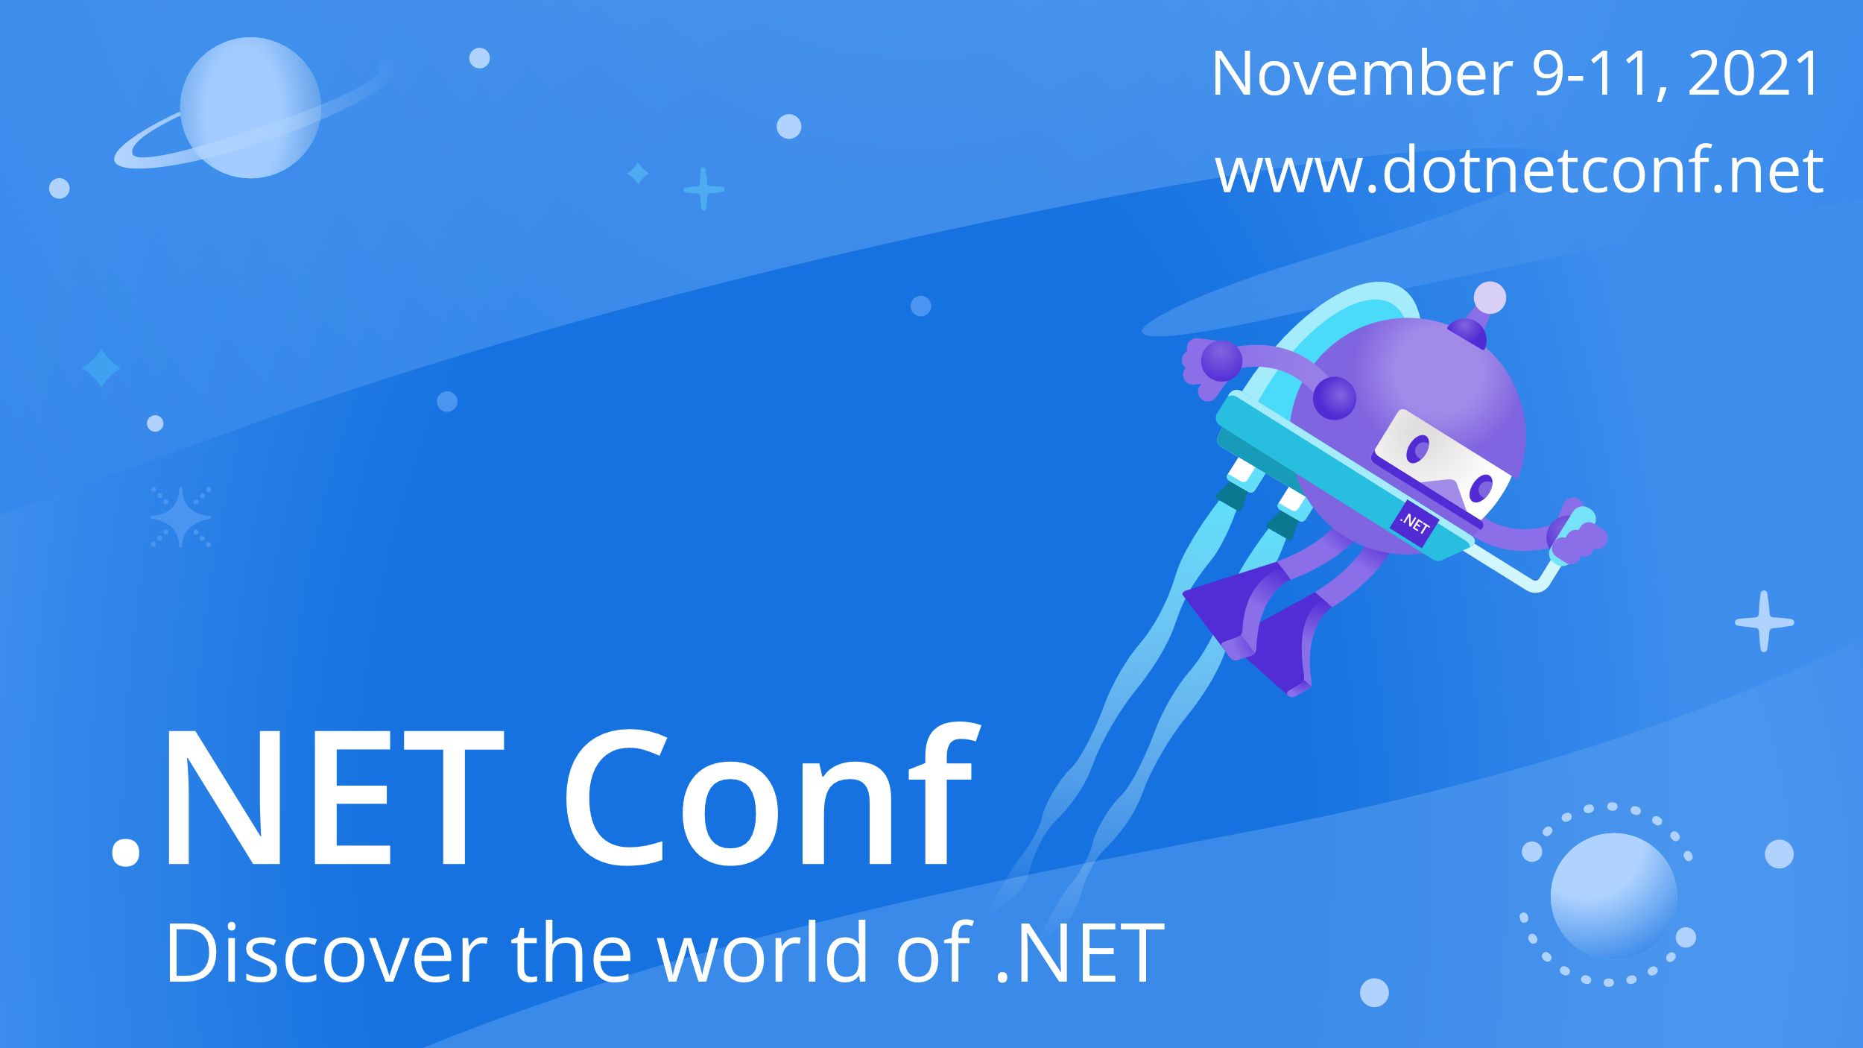

Slide 2



OpenTelemetry with ASP.NET Core Minimal APIs
Marco Minerva
Microsoft MVP
Andrea Tosato
Microsoft MVP
Cloudgen Verona
HUDI

Slide 3
Demo
The Minimal API project
Notes:
5 minutes
Branch Minimal API
Database
Computer Vision

Slide 4
OpenTelemetry

Slide 5
Metrics, logs, and traces, oh my!
Metrics
Aggregated summary statistics.
Logs
Detailed debugging information emitted by processes.
Distributed Tracing
Provides insights into the full lifecycles, aka traces of requests to a system, allowing you to pinpoint failures and performance issues.
Structured data can be transmuted into any of these!

Slide 6
Tracing concepts in a nutshell
Span
Represents a single unit of work in a system.
Typically encapsulates: operation name, a start and finish timestamp, the parent span identifier, the span identifier, and context items.
Trace
Defined implicitly by its spans. A trace can be thought of as a directed acyclic graph of spans where the edges between spans are defined as parent/child relationships.
DistributedContext
Contains the tracing identifiers, tags, and options that are propagated from parent to child spans

Slide 7
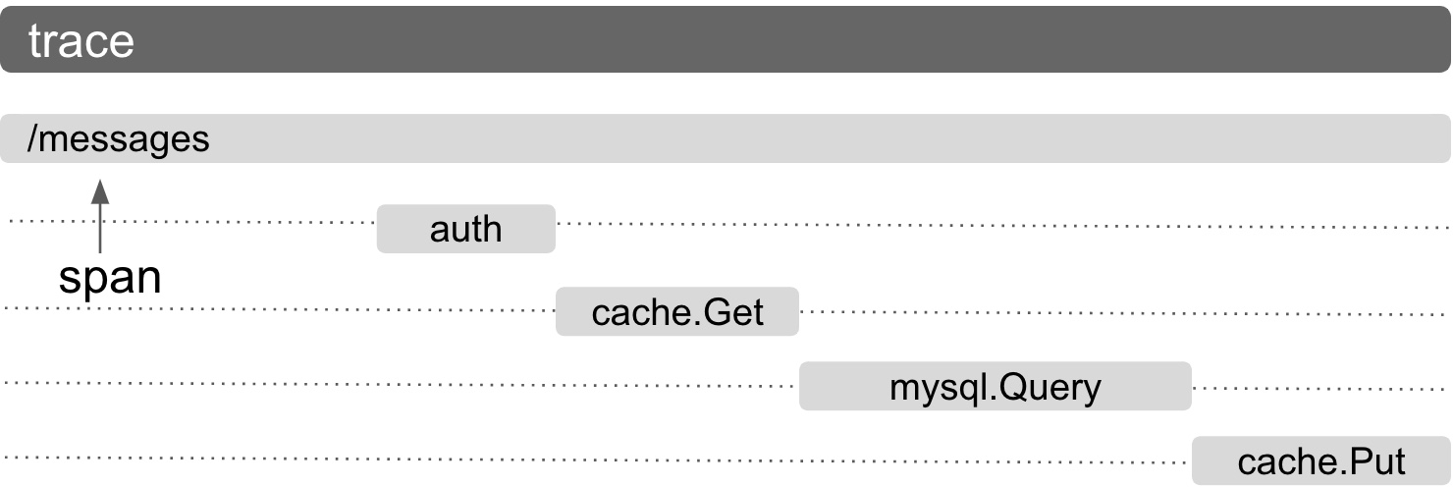
Tracing concepts

Slide 8



OTeL - Component
Receiver
Processor
Exporter

Slide 9
Demo
OpenTelemetry with ASP.NET Core Minimal APIs

Slide 10
References
https://opentelemetry.io
https://github.com/open-telemetry/opentelemetry-dotnet
https://github.com/andreatosato/Photobook

Slide 11


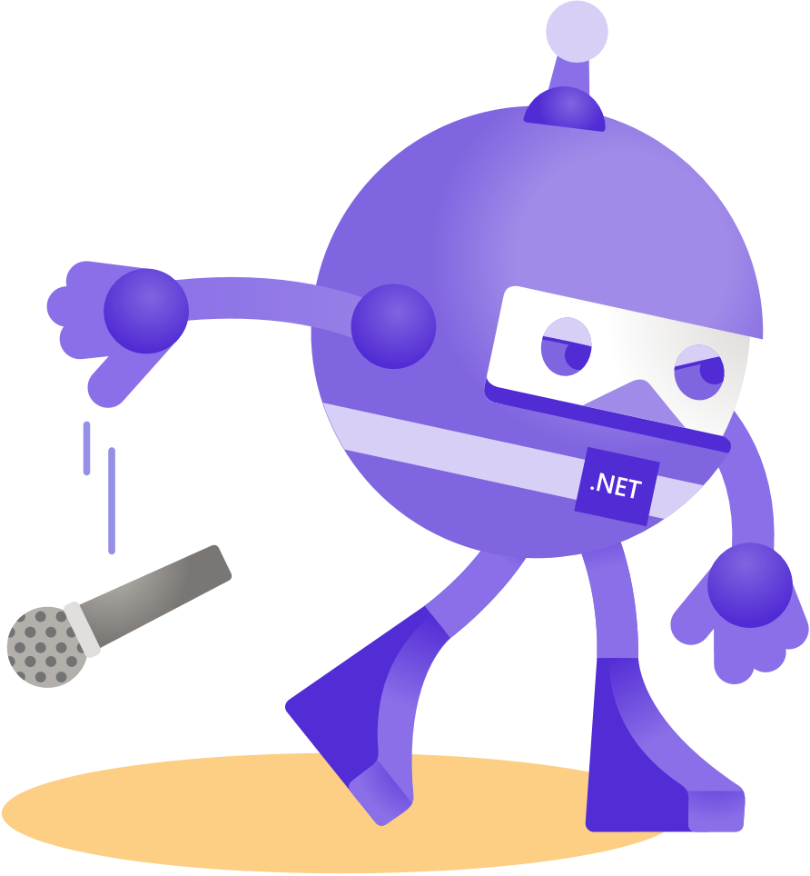

Thanks for joining!
twitch.tv/cloudgenverona
twitch.tv/marcominerva
youtube.com/cloudgenverona
youtube.com/marcominerva
github.com/andreatosato
github.com/marcominerva
@ATosato86
@marcominerva
linkedin.com/in/andreatosato
linkedin.com/in/marcominerva

